Slide 1


Video Imagination from a Single Image with Transformation Generation
Baoyang Chen, Wenmin Wang, Jinzhuo Wang
School of Electronics and Computer Engineering, Peking University
Notes:
Hi, everyone. I will be talking about our recent work on a novel task : video Imagination

Slide 2
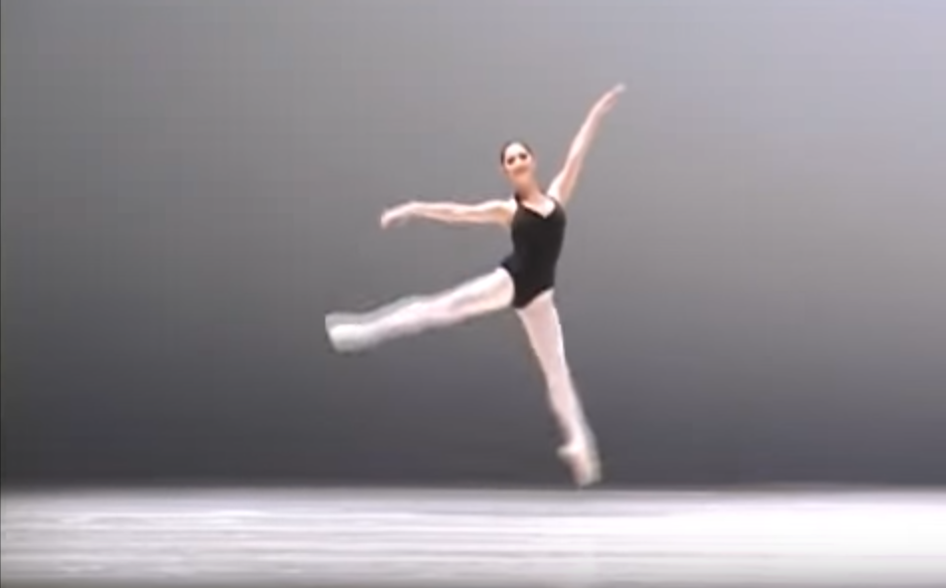
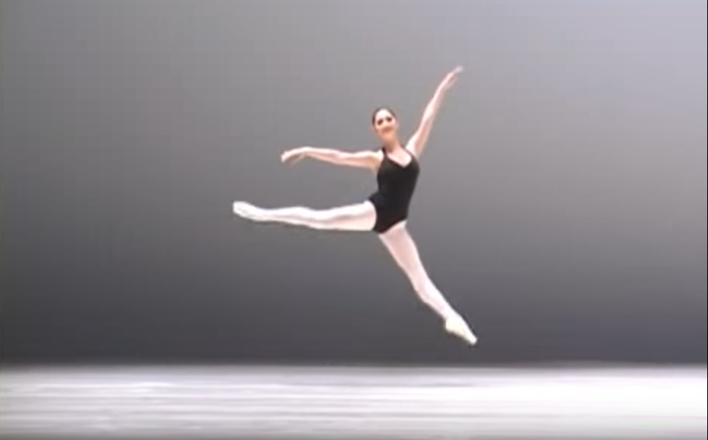
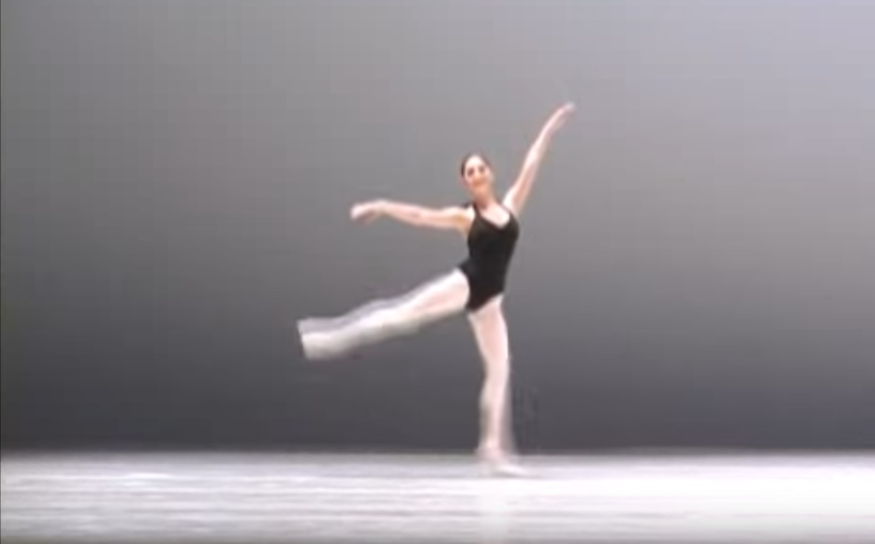
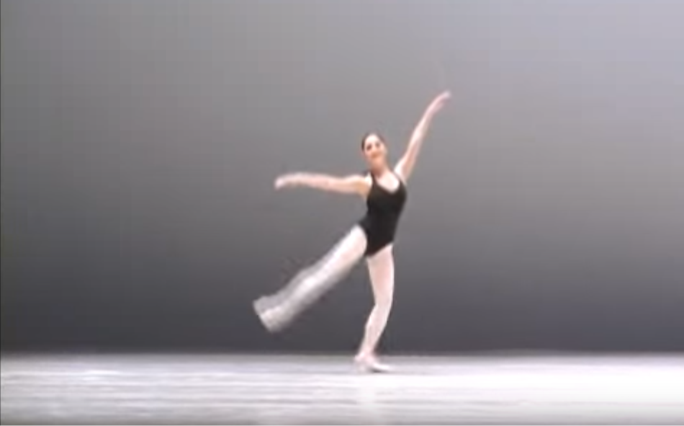
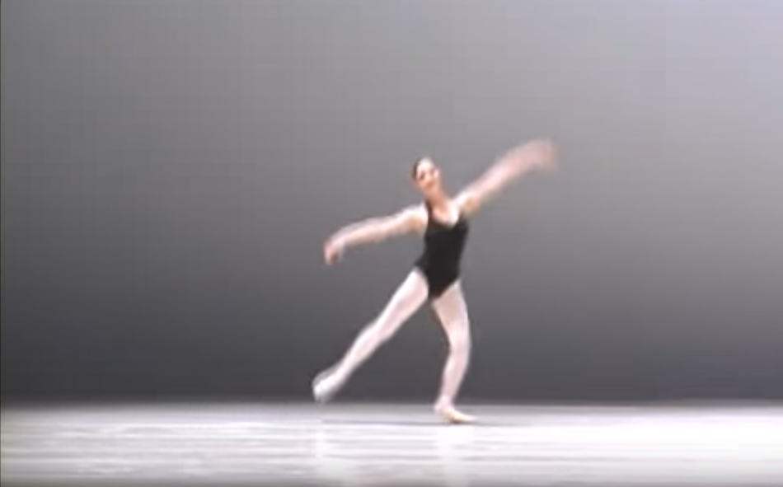

Video imagination
Time
Plausible
Imaginary video 1
Single image
Plausible
Imaginary video 2
Notes:
First of all , I would like to introduce what is video Imagination.: take one single image as input, output various frames forming various plausible imaginary videos.

Slide 3
Task & Challenge
Input → Output
Single image → multiple videos
Challenges:
Limited information
High-dimension and consecutive frames
No precise ground truth
Requirement of new criterion
Notes:
This task is challenging. As u can c,

Slide 4
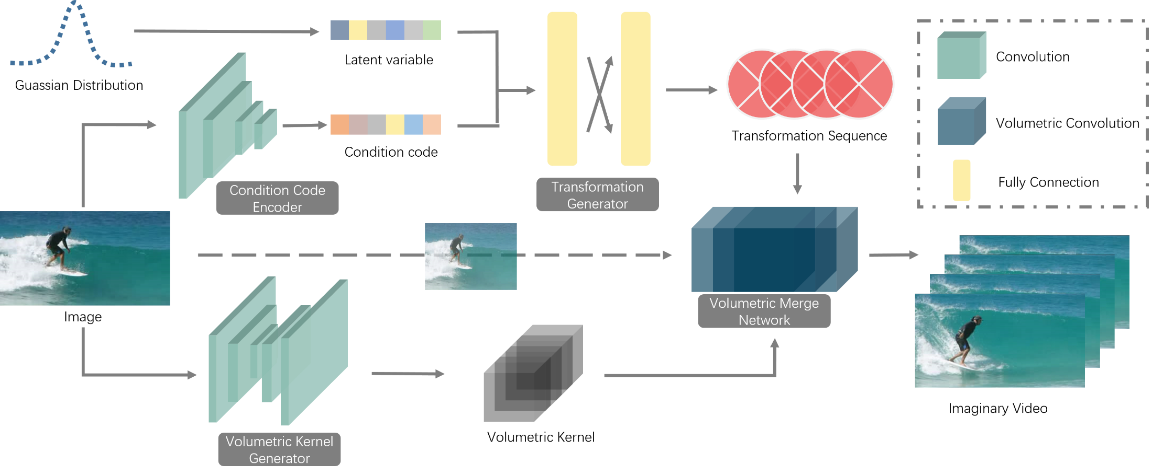
Genration Framework

Slide 5
Adversarial Training
Time
Transformation
Sequence 1
Imaginary video 1
Single image
Transformation
Sequence 2
Video Critic Network
Similar to Discriminator in traditional GAN framework
Imaginary video 2
Notes:
First of all , I would like to introduce what is video Imagination. If you are shown one single image as this ballerina. Its even intuitionally for you to imagine two distinct scenes starting with this image. If we describe this capability in a way computer can understand: we have the description of this task: take one single image as input, output various plausible frames forming various imaginary videos.

Slide 6
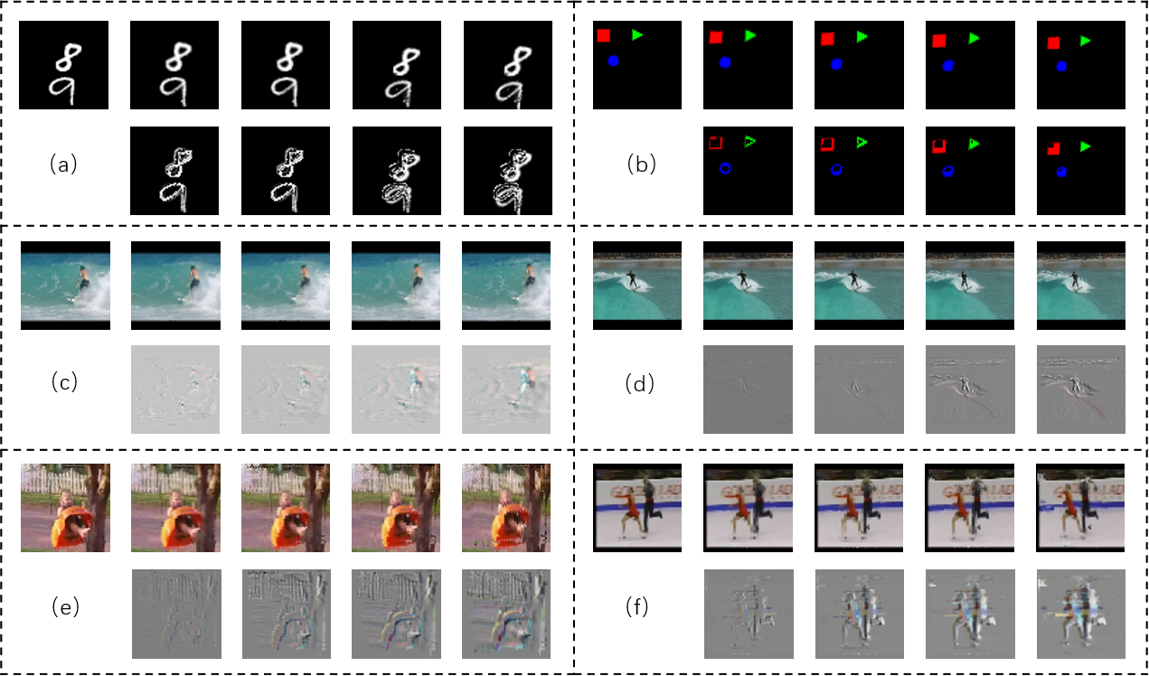
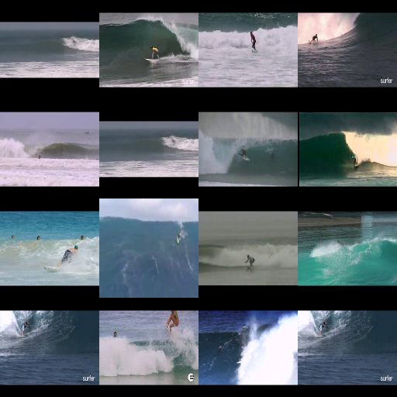

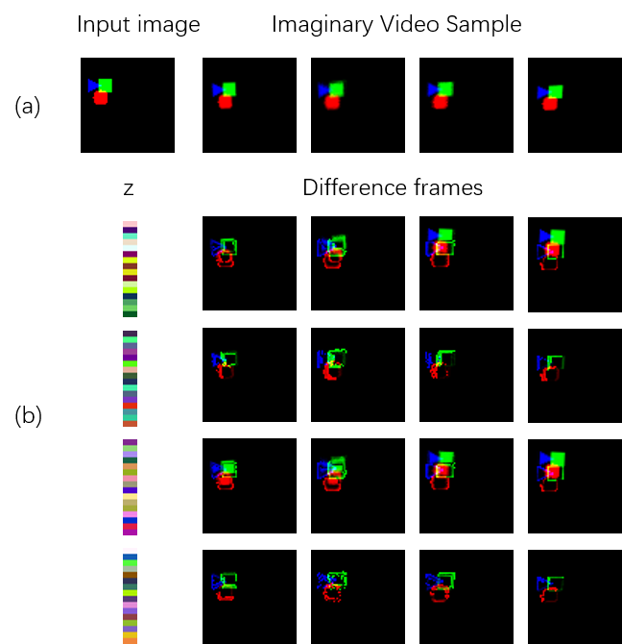
Result

